Slide 1
Invasive & Non-Invasive Haemoglobin Detection
Guide : Prof. Dipankar Bandyopadhyay
By : Ahemad Khan Pathan 180107004
ahemad@iitg.ac.in
Dept. of Chemical Engineering

Slide 2
Timeline
Literature Survey & Comparative Study
Collection of Dataset
Study of Bio-Sensors
Data Analysis
Development of Primitive Algorithm / Model
Experimenting with different Models possible
Incorporating Detection of Sodium, Potassium and Hemoglobin in one model
Development of Quality Control Software
Algorithm Review and Efficiency Comparison with Available Data

Slide 3
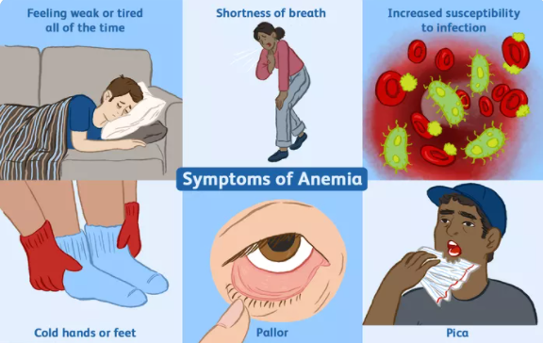
Hemoglobin & Anemia
Hemoglobin : A protein in RBCs. It carries
oxygen to organs and tissues
of human body and transports
back CO₂ to lungs.
Anemia : A biological condition in which
body lacks enough red blood-
cells of the to carry adequate
oxygen to tissues.
According WHO, at least 2 Billion of world
population is anaemic. And needs time to
time testing for monitoring the same.

Slide 4

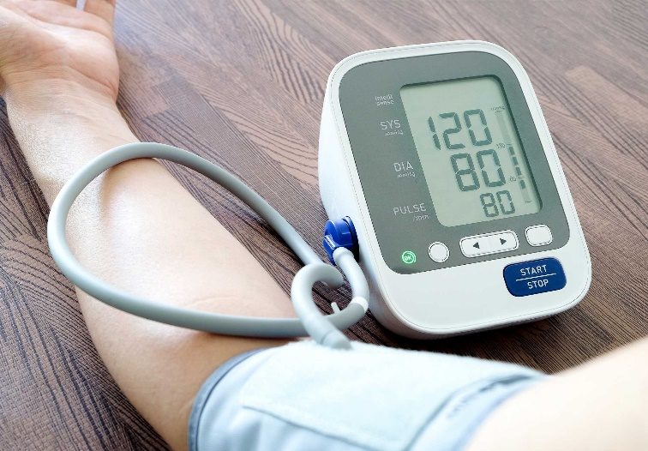
Invasive & Non-Invasive Procedure
Invasive Procedure :
It is a type of medical procedure that trained medical practitioners use to cut skin (or other connective tissue) with the help of medical instruments.
e.g. Using Injection, Surgery
Non-Invasive Procedure :
Unlike Invasive test, there is no need for cutting the skin
or entering into the human body.
e.g. Checking Bloop Pressure, X Rays

Slide 5
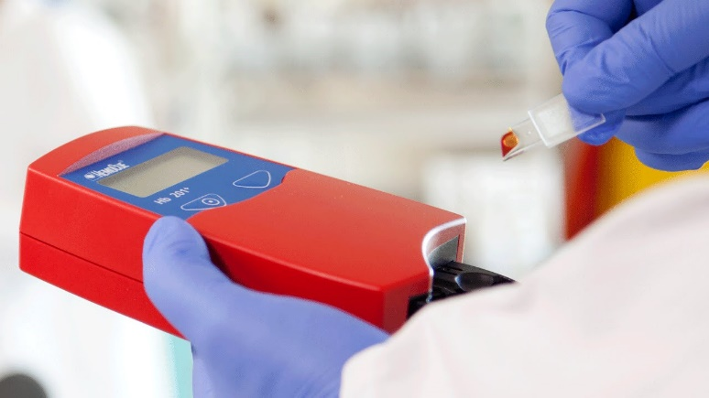
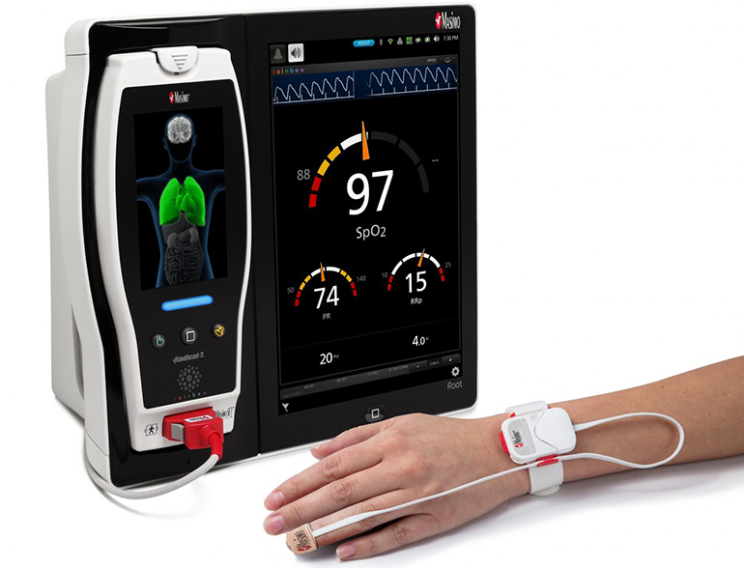
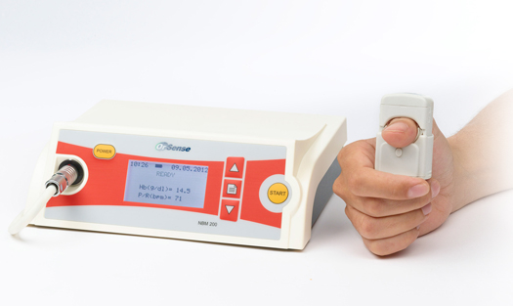
POCT Devices for Hemoglobin Measurement
HemoCue System – Invasive Testing
Masimo Rad 7 – Non-Invasive Testing
NBM 200 – Non-Invasive Testing

Slide 6
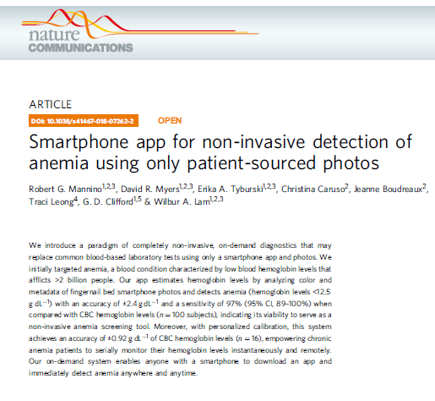

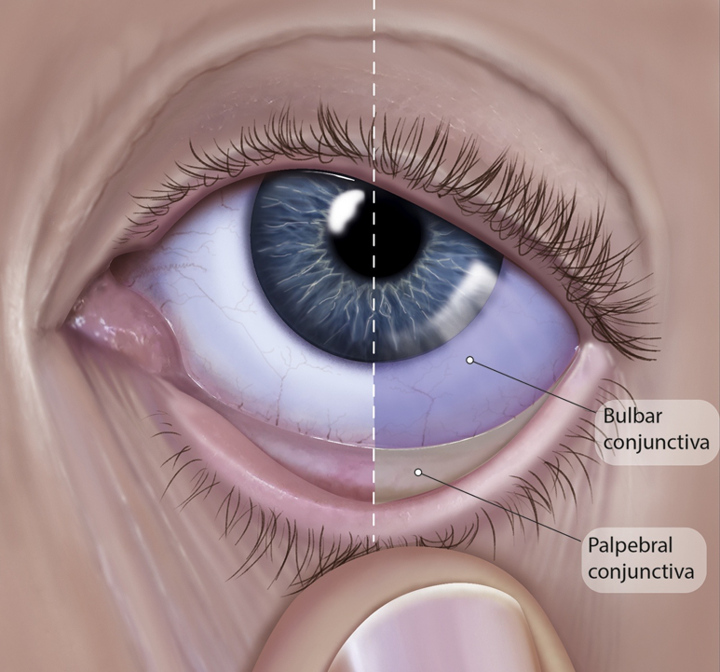
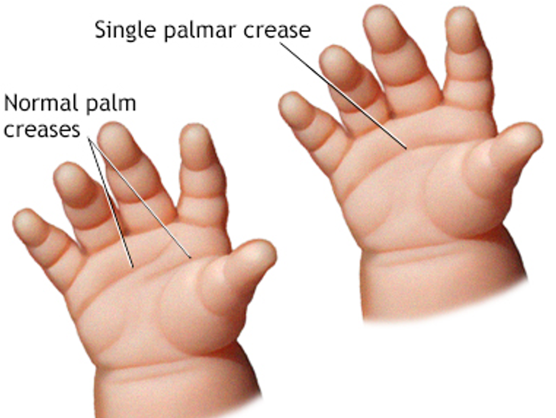
Literature
Smartphone app for non-invasive detection of
anemia using only patient-sourced photos

Slide 7
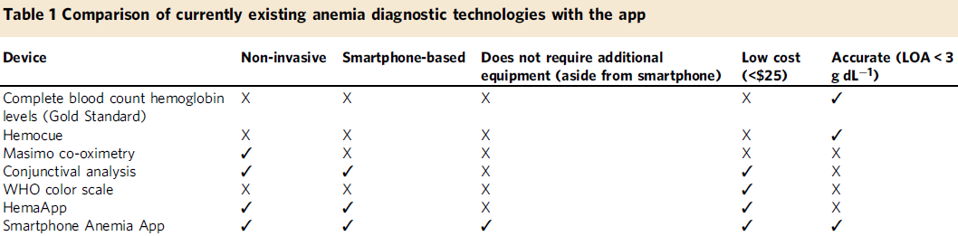
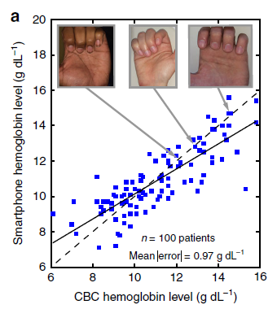


Slide 8
References
Smartphone app for non-invasive detection of anemia using only patient-sourced photos | Robert G. Mannino, David R. Myers, Erika A. Tyburski, Christina Caruso, Jeanne Boudreaux, Traci Leong, G. D. Clifford & Wilbur A. Lam
Non-invasive hemoglobin measurement using embedded platform | Caje Pinto ,
Jivan Parab, Gourish Naik
How Noninvasive Hemoglobin Measurement with Pulse CO-Oximetry Can Change Your Practice: An Expert Review | Gregor Lindner and Aristomenis K. Exadaktylos
https://en.wikipedia.org/wiki/Invasive_test
https://en.wikipedia.org/wiki/Non-invasive_procedure

Slide 9
THANK YOU
Guide : Prof. Dipankar Bandyopadhyay
By Ahemad Khan Pathan 180107004
ahemad@iitg.ac.in
Dept. of Chemical Engineering

